Slide 1
ASTTN (Adaptive Graph Spatial-Temporal Transformer Network for Traffic Forecasting)
17 October 2022
CIKM
Author: Aosong Feng, Leandros Tassiulas
Speaker: Tianpu Zhang

Slide 2
Introduction
Dataset
METRA-LA
PeMSD7
PEMS-BAY
PeMSD4
Cons for previous research works
Most previous works process spatial dimension and temporal dimension separately by using different modules.
Most previous works predetermined graph structure built from the distance measure or other geographical connections.
Even with the graph which captures the true dependencies among nodes, the spatial correlations can be dynamically changing across different time steps.

Slide 3



Preliminaries
Sptaio-temporal features
Problem definition
$$\left({\hat{x}}^{t+1},{…,\hat{x}}^{t+T}\right)=f\left(X^{t−T+1},{…,X }^{t};G\right)$$
Adjacent matrix
$$A∈R^{N∗N}$$
Feature matrix on graph at step t
Notes:
对于指定时刻图上的特征用X_t表示 其中x_t^1表示第一个节点第t个时刻的特征

Slide 4
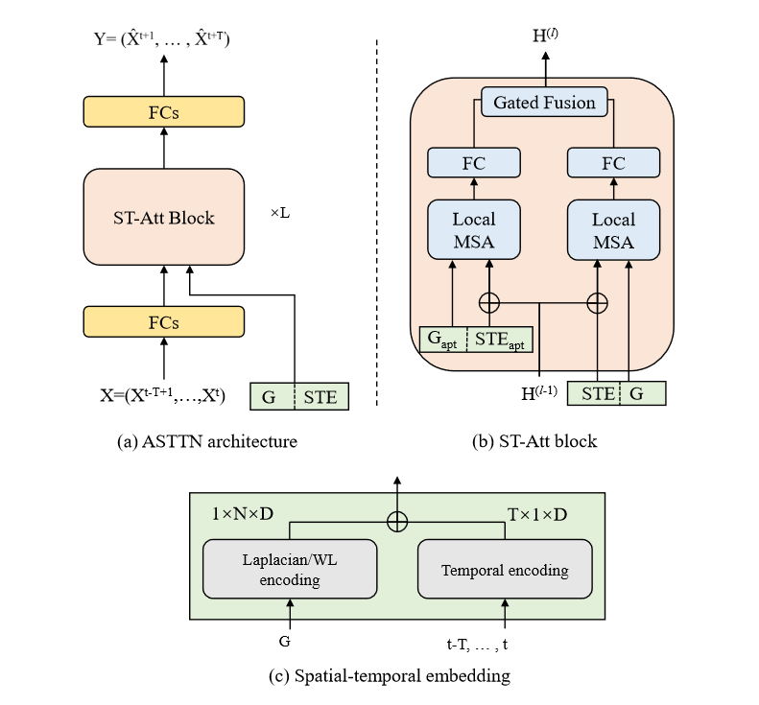
Overview

Slide 5

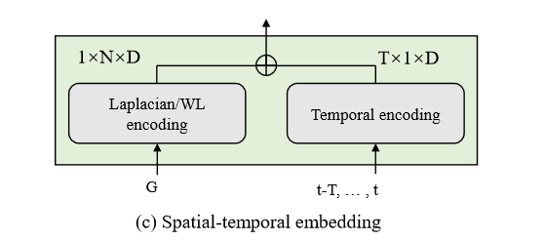
Spatial-Temporal Embedding
Laplacian encoding
We use the k smallest non-trivial eigenvectors of a node as its positional encoding and denote by λi for node i.
Temporal embedding
we use the day-of-week and time-of-day of each time step to compose the two-dimensional temporal encoding。

Slide 6
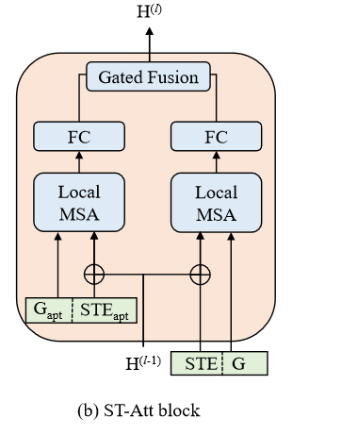

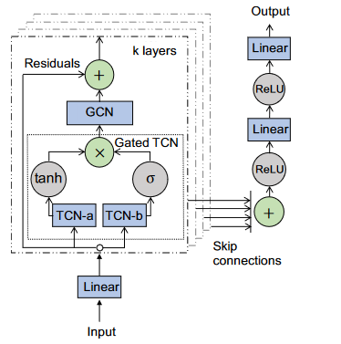






ST-Attention Block
Input
Gumbel-sigmoid
$${STE}_{apt}$$
$$STE$$
Local MSA
Eric Jang, Shixiang Gu, and Ben Poole. 2016. Categorical reparameterization with gumbel-softmax. arXiv preprint arXiv:1611.01144 (2016).

Slide 7


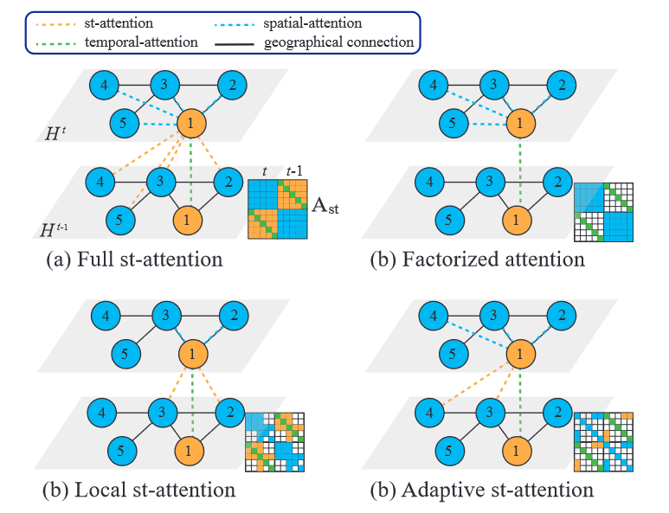




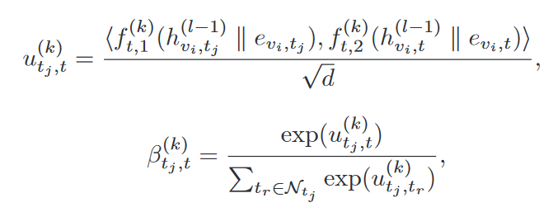
ST-Attention Block
Chuanpan Zheng, Xiaoliang Fan, Cheng Wang, and Jianzhong Qi. 2020. Gman: A graph multi-attention network for traffic prediction. In Proceedings of the AAAI Conference on Artificial Intelligence, Vol. 34. 1234–1241

Slide 8
Advantage
A way of combination GCN and self-attention is applied.
Stacking self-attention is viable alternative to the encoder-decoder model for predicting traffic issues.

Slide 9
END
Thank you

